Slide 1


Galgotias College of Engineering and Technology, Greater Noida
Set Theory, Relation, Function
UNIT-1
Discrete Mathematics
Aditya Narayan Singh
Assistant Professor
Department of MCA
MCA
Ist Sem

Slide 2
Course Objective
The subject enhances one’s ability to develop logical thinking and ability to problem solving.
The objective of discrete Mathematics is to enables students to formulate problems precisely, solve the problems, apply formal proofs techniques and explain their reasoning clearly.

Slide 3
Course Outcome
Course Outcome (CO) | At the end of course , the student will be able to | Bloom’s Knowledge Level (KL)
CO1 | Use mathematical and logical notation to define and formally reason about basic discrete structures such as Sets, Relations and Functions | K1, K2
CO2 | Apply mathematical arguments using logical connectives and quantifiers to check the validity of an argument through truth tables and propositional and predicate logic | K2,K3
CO3 | Identify and prove properties of Algebraic Structures like Groups, Rings and Fields . | K3, K4
CO4 | Formulate and solve recurrences and recursive functions . | K3, K4
CO5 | Apply the concept of combinatorics to solve basic problems in discrete mathematics | K1, K3

Slide 4
Syllabus
UNIT-I Set Theory, Relation, Function
Set Theory: Introduction, Size of sets and Cardinals, Venn diagrams, Combination of sets, Multisets, Ordered pairs and Set Identities. Relation: Definition, Operations on relations, Composite relations, Properties of relations, Equality of relations, Partial order relation.
Functions: Definition, Classification of functions, Operations on functions, Recursively defined functions.
UNIT-II Posets, Hasse Diagram and Lattices
Posets, Hasse Diagram and Lattices: Introduction, Partial ordered sets, Combination of Partial ordered sets, Hasse diagram, Introduction of lattices, Properties of lattices – Bounded, Complemented, Modular and Complete lattice. Boolean Algebra: Introduction, Axioms and Theorems of Boolean algebra, Boolean functions. Simplification of Boolean functions, Karnaugh maps, Logic gates.

Slide 5
Syllabus
UNIT-III Propositional and Predicate Logic
Propositional: Propositions, Truth tables, Tautology, Contradiction, Algebra of Propositions, Theory of Inference and Natural Detection. Predicate Logic: Theory of Predicates, First order predicate, Predicate formulas, Quantifiers, Inference theory of predicate logic.
UNIT-IV Algebraic Structures, Rings and Fields
Algebraic Structures:Introduction to algebraic Structures and properties. Types of algebraic structures: Semi group, Monoid, Group, Abelian group and Properties of group. Subgroup, Cyclic group, Cosets, Permutation groups, Homomorphism and Isomorphism of groups.
Rings and Fields: Definition and elementary properties of Rings and Fields.

Slide 6
Syllabus
UNIT-V Natural Numbers, Recurrence Relation & Generating functions and Combinatorics
Natural Numbers: Introduction, Piano’s axioms, Mathematical Induction, Strong Induction and Induction with Nonzero Base cases. Recurrence Relation & Generating functions: Introduction and properties of Generating Functions. Simple Recurrence relation with constant coefficients and Linear recurrence relation without constant coefficients. Methods of solving recurrences.
Combinatorics: Introduction, Counting techniques and Pigeonhole principle, Polya’s Counting theorem.

Slide 7
Prerequisite & Recap
Prerequisite
Knowledge of Mathematics upto 12th standard.
Recap
The fundamental concepts of Sets, Relations and Functions, Logic, Probability and Boolean Algebra.

Slide 8
Topic Objectives: Set Theory (CO1)
The student will be able to:
Represent a set using set-builder notation.
Give examples of finite and infinite sets.
Build new sets from existing sets by applying various combinations of the set operations for example intersection union, difference, and complement.
Determine whether two sets are equal by determining whether each is a subset of the other
Sets are used to define the concepts of relations and functions. The study of geometry, sequences, probability, etc. requires the knowledge of sets.

Slide 9
Topic Prerequisite & Recap (CO1)
Prerequisite
Basic Understanding of mathematical objects and notions such as rational and real number fields.
Idea of surjective, injective and bijective functions.
Recap
Understanding of Boolean algebra axioms.

Slide 10
Introduction to Sets (CO1)
A set is an unordered collection of distinct objects, called elements or members of the set.
A set is said to contain its elements.
Sets are used to group objects together. Often, but not always, the objects in a set have similar properties.
An object can be numbers, alphabets, names, etc.
The idea of set theory is to turn logical predications, like "x is less than 100 and x is greater than 1", into objects which can be manipulated by good formal rules.
Set theory is important because it is a theory of integers, models of axiom systems, infinite ordinals, and real numbers, all in one unified structure.

Slide 11
Introduction to Sets (CO1)
Examples of sets are:
A set of natural numbers.
A set of rivers of India.
A set of vowels in English alphabets.
We broadly denote a set by the capital letter A, B, C, etc. while the fundamentals of the set by small letter a, b, x, y, etc.
A is a set, and “a” is one of the elements of A
We denote it as a ∈ A.
Here the symbol ∈ means – “Belongs to” or “Element of”

Slide 12
Introduction to Sets (CO1)
Two sets are equal if and only if they have the same elements. Therefore, if A and B are sets, then A and B are equal if and only if ∀x(x ∈ A ↔ x ∈ B).
We write A = B if A and B are equal sets.
The sets {1, 3, 5} and {3, 5, 1} are equal, because they have the same elements.
Set {1, 3, 3, 3, 5, 5, 5, 5} is the same as the set {1, 3, 5}.
A set is said to be infinite if it is not finite.

Slide 13
Sets Representation (CO1)
Sets are represented in two forms:
Roster or tabular form: In this form of representation, we list all the elements of the set within braces { } and separate them by commas.
Example:
If A = Set of all odd numbers less then 10, then A = { 1, 3, 5, 7, 9}.
If B = Set of vowel of English alphabets, then B = {‘a’, ‘e’, ‘i’, ‘o’, ‘u’ }.
Set Builder form: In this form of representation, we list the properties fulfilled by all the elements of the set. We note as {x: x satisfies properties P}and read as 'the set of all x such that each x has properties P’.
Example:
If A = {1, 3, 5, 7, 9}, then A = {x : x=2n-1, where n ∈ N and n ≤ 5}
If B = {2, 4, 8, 16, 32, 64, 128}, then B={x : x=2^{n}, where n ∈ N and n < 8}

Slide 14
Standard Notations (CO1)
x ∈ A | x belongs to A or x is an element of set A.
x ∉ A | x does not belong to set A.
∅ or {} | Empty Set.
U | Universal Set.
N | The set of all natural numbers or {1, 2, 3, 4, 5, 6, 7, …}
I/Z | The set of all integers or {…, -3, -2, -1, 0, 1, 2, 3,….}
Z0/I0 | The set of all non- zero integers or {…,-3, -2, -1, 1, 2, 3, …}
Z+/I+ | The set of all + ve integers or {1, 2, 3, 4, 5, …}
C, C₀ | The set of all complex, non-zero complex numbers respectively.
Q, Q₀, Q₊ | The sets of rational, non- zero rational, +ve rational numbers respectively.
R, R₀, R₊ | The set of real, non-zero real, +ve real number respectively.

Slide 15
Cardinality (CO1)
The total number of unique elements in the set is called the cardinality of the set.
If A is the set, then cardinality is denoted as |A| , n (A), #A or card(A).
Examples:
Let P = {k, l, m, n} The cardinality of the set P is 4 i.e. n(P) = 4
Let A is the set of all non-negative even integers, i.e. A = {0, 2, 4, 6, 8, 10, ....}.
As A is countably infinite set and so the cardinality.

Slide 16
Types of Sets (CO1)
Sets can be classified into many categories. Some of which are finite, infinite, subset, universal, proper, power, singleton set, etc.
Singleton Set: It contains only one element. It is denoted by {a}.
Example: S= {x | x ∈ N, 7 < x < 9} = {8}
Null Set or Empty Set: A set having no elements is called a Null set or void set. It is denoted by ∅ or {}.
Subsets: If every element in a set A is also an element of a set B, then A is called a subset of B. It can be denoted as A ⊆ B. Here B is called Superset of A. Example: If A= {1, 2} and B= {4, 2, 1} the A is the subset of B or A ⊆ B.
Every set is a subset of itself.
The Null Set i.e. ∅ is a subset of every set.
If A is a subset of B and B is a subset of C, then A will be the subset of C. If A⊂B and B⊂ C ⟹ A ⊂ C
A finite set having n elements has 2^{n} subsets.

Slide 17
Types of Sets (CO1)
Proper Subset: If A is a subset of B and A ≠ B then A is said to be a proper subset of B. If A is a proper subset of B then B is not a subset of A, i.e., there is at least one element in B which is not in A.
Example: A = {1, 2} and B = {1, 2, 3, 4}. A is proper subset of B.
The null ∅ is a proper subset of every non-void set.
Improper Subset: If A is a subset of B and A = B, then A is said to be an improper subset of B.
Example
A = {2, 3, 4}, B = {2, 3, 4} => A is an improper subset of B.
Every set is an improper subset of itself.

Slide 18
Types of Sets (CO1)
Infinite Sets: A set which is not finite is called as Infinite Sets.
It is of two types :
Countable Infinite: If there is one to one correspondence between the elements in set and element in N. A countably infinite set is also known as Denumerable. A set that is either finite or denumerable is known as countable. A set which is not countable is known as Uncountable. The set of a non-negative even integer is countable Infinite.
Uncountable Infinite: A set which is not countable is called Uncountable Infinite Set or non-denumerable set or simply Uncountable.
Example: Set R of all +ve real numbers less than 1 that can be represented by
the decimal form 0. a₁a₂a₃..... Where a₁ is an integer such that 0 ≤ a_{i} ≤ 9.

Slide 19
Types of Sets (CO1)
Equal Sets: Two sets A and B are said to be equal and written as A = B if both have the same elements. Therefore, every element which belongs to A is also an element of the set B and every element which belongs to the set B is also an element of the set A.
A = B ⟺ {x ϵ A ⟺ x ϵ B}.
If there is some element in set A that does not belong to set B or vice versa then
A ≠ B, i.e., A is not equal to B.
Equivalent Sets: If the cardinalities of two sets are equal, they are called equivalent sets.
Example: If A= {1, 2, 6} and B= {16, 17, 22}, they are equivalent as cardinality of
A is equal to the cardinality of B. i.e. |A|=|B|=3

Slide 20
Types of Sets (CO1)
Disjoint Sets: Two sets A and B are said to be disjoint if no element of A is in B and no element of B is in A.
Example:
N = {1, 2, 3}, S = {k, p, m}
N and S are disjoint sets.
Power Sets: The power of any given set A is the set of all subsets of A and is denoted by P (A). If A has n elements, then P (A) has 2^{n} elements.
Example: A = {1, 2, 3}
P (A) = {∅, {1}, {2}, {3}, {1, 2}, {1, 3}, {2, 3}, {1, 2, 3}}.

Slide 21
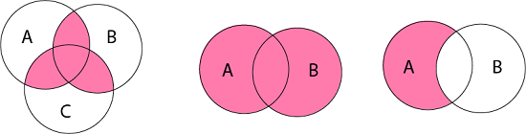
Venn Diagrams (CO1)
Venn diagram is a pictorial representation of sets in which an enclosed area in the plane represents sets.
Examples:

Slide 22
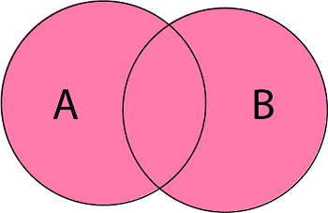
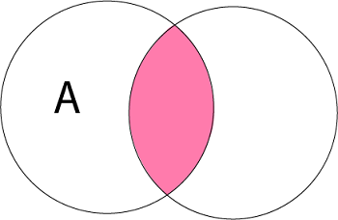
Operations on Sets (CO1)
The basic set operations are:
Union of Sets: Union of Sets A and B is defined to be the set of all those elements which belong to A or B or both and is denoted by A∪B.
A ∪ B = {x: x ∈ A or x ∈ B}
Example: Let A = {1, 2, 3}, B= {3, 4, 5, 6} A ∪ B = {1, 2, 3, 4, 5, 6}.
Intersection of Sets: Intersection of two sets A and B is the set of all those elements which belong to both A and B and is denoted by A ∩ B.
A ∩ B = {x: x ∈ A and x ∈ B}
Example: Let A = {11, 12, 13}, B = {13, 14, 15} A ∩ B = {13}.
B

Slide 23
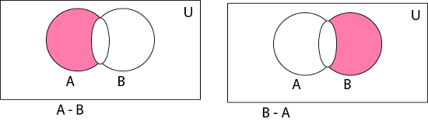
Operations on Sets (CO1)
Difference of Sets: The difference of two sets A and B is a set of all those elements which belongs to A but do not belong to B and is denoted by A - B.
A - B = {x: x ∈ A and x ∉ B}
Example: Let A= {1, 2, 3, 4} and B={3, 4, 5, 6} then A - B = {1, 2}
and B - A = {5, 6}

Slide 24

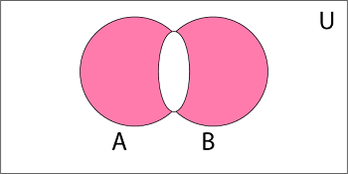
Operations on Sets (CO1)
Complement of a Set: The Complement of a Set A is a set of all those elements of the universal set which do not belong to A and is denoted by A^{c}.
A^{c} = U - A = {x: x ∈ U and x ∉ A} = {x: x ∉ A}
Example: Let U is the set of all natural numbers. A = {1, 2, 3} A^{c} = {all natural numbers except 1, 2, and 3}.
Symmetric Difference of Sets: The symmetric difference of two sets A and B is the set containing all the elements that are in A or B but not in both and is denoted by A ⨁ B i.e.
A ⨁ B = (A ∪ B) - (A ∩ B)
Example: Let A = {a, b, c, d} B = {a, b, l, m} A ⨁ B = {c, d, l, m}

Slide 25
Algebra of Sets (CO1)
1 | Idempotent Laws | (a) A ∪ A = A | (b) A ∩ A = A
2 | Associative Laws | (A ∪ B) ∪ C = A ∪ (B ∪ C) | (b) (A ∩ B) ∩ C = A ∩ (B ∩ C)
3 | Commutative Laws | (a) A ∪ B = B ∪ A | (b) A ∩ B = B ∩ A
4 | Distributive Laws | A ∪ (B ∩ C) = (A ∪ B) ∩ (A ∪ C) | (b) A ∩ (B ∪ C) = (A ∩ B) ∪ (A ∩ C)
5 | De Morgan's Laws | (a) (A ∪B)^{c}=A^{c}∩ B^{c} | (b) (A ∩B)^{c}=A^{c}∪ B^{c}
6 | Identity Laws | (a) A ∪ ∅ = A (b) A ∪ U = U | (c) A ∩ U =A (d) A ∩ ∅ = ∅
7 | Complement Laws | (a) A ∪ A^{c}= U (b) A ∩ A^{c}= ∅ | (c) U^{c}= ∅ (d) ∅^{c} = U
8 | Involution Law | (a) (A^{c})^{c} = A

Slide 26
Idempotent Law (CO1)
(a) A ∪ A = A
Solution:
Since, B ⊂ A ∪ B, therefore A ⊂ A ∪ B
Let x ∈ A ∪ A ⇒ x ∈ A or x ∈ A ⇒ x ∈ A
∴ A ∪ A ⊂ A
As A ∪ A ⊂ A and A ⊂ A ∪ A ⇒ A =A ∪ A. Hence Proved.
(b) A ∩ A = A
Solution:
Since, A ∩ B ⊂ B, therefore A ∩ A ⊂ A
Let x ∈ A ⇒ x ∈ A and x ∈ A ⇒ x ∈ A ∩ A
∴ A ⊂ A ∩ A
As A ∩ A ⊂ A and A ⊂ A ∩ A ⇒ A = A ∩ A. Hence Proved.

Slide 27
Associative Law (CO1)
(a) (A ∪ B) ∪ C = A ∪ (B ∪ C)
Solution:
Let some x ∈ (A ∪ B) ∪ C
⇒ (x ∈ A or x ∈ B) or x ∈ C
⇒ x ∈ A or x ∈ B or x ∈ C
⇒ x ∈ A or (x ∈ B or x ∈ C)
⇒ x ∈ A or x ∈ B ∪ C
⇒ x ∈ A ∪ (B ∪ C)
⇒ (A ∪ B) ∪ C ⊂ A ∪ (B ∪ C)………….(i)
Similarly, if some x ∈ A ∪ (B ∪ C),
then x ∈ (A ∪ B) ∪ C.
∴ A ∪ (B ∪ C) ⊂ (A ∪ B) ∪ C ………………….(ii)
From (i) and (ii), we have
(A ∪ B) ∪ C = A ∪ (B ∪ C) Hence Proved.

Slide 28
Associative Laws (CO1)
(b) (A ∩ B) ∩ C = A ∩ (B ∩ C)
Solution:
Let some x ∈ A ∩ (B ∩ C)
⇒ x ∈ A and x ∈ B ∩ C
⇒ x ∈ A and (x ∈ B and x ∈ C)
⇒ x ∈ A and x ∈ B and x ∈ C
⇒ (x ∈ A and x ∈ B) and x ∈ C)
⇒ x ∈ A ∩ B and x ∈ C
⇒ x ∈ (A ∩ B) ∩ C ⇒ A ∩ (B ∩ C) ⊂ (A ∩ B) ∩ C
Similarly, if some x ∈ A ∩ (B ∩ C),
then x ∈ (A ∩ B) ∩ C
⇒ (A ∩ B) ∩ C ⊂ A ∩ (B ∩ C)
⇒ (A ∩ B) ∩ C = A ∩ (B ∩ C)
Hence Proved.

Slide 29
Commutative Law (CO1)
(a) A ∪ B = B ∪ A
Solution:
To Prove A ∪ B = B ∪ A
A ∪ B = {x: x ∈ A or x ∈ B} = {x: x ∈ B or x ∈ A}
(∵ Order is not preserved in case of sets)
A ∪ B = B ∪ A.
Hence Proved.
(b) A ∩ B = B ∩ A
Solution:
To Prove A ∩ B = B ∩ A
A ∩ B = {x: x ∈ A and x ∈ B} = {x: x ∈ B and x ∈ A}
(∵ Order is not preserved in case of sets)
A ∩ B = B ∩ A.
Hence Proved.

Slide 30
Complement Laws (CO1)
(a) A ∪ A^{c}= U
Solution:
To Prove A ∪ A^{c}= U
Every set is a subset of U
∴ A ∪ A^{c} ⊂ U.................. (i)
We have to show that U ⊆ A ∪ A^{c}
Let x ∈ U
⇒ x ∈ A or x ∉ A
⇒ x ∈ A or x ∈ A^{c}
⇒ x ∈ A ∪ A^{c}
∴ U ⊆ A ∪ A^{c}................... (ii)
From (i) and (ii), we get A ∪ A^{c}= U. Hence Proved.
(b) ∅^{c} = U
Solution:
Let x ∈ ∅^{c} ⇒ x ∉ ∅ ⇒ x ∈ U ⇒ ∅^{c} ⊆ U……….(i)
Now, Let y ∈ U ⇒ y ∉ ∅ ⇒ y ∈ ∅^{c} ……….(ii)
From (i) and (ii), we have ∅^{c} = U. Hence Proved.

Slide 31
Complement Laws (CO1)
(c) U^{c}= ∅
Solution:
Let x ∈ U^{c} ⇒ x ∉ U ⇒ x ∈ ∅ ⇒ U^{c} ⊆ ∅ ………(i)
Now, Let x ∈ ∅ ⇒ x ∉ U ⇒ x ∈ U^{c} ⇒ ∅ ⊆ U^{c}............(ii)
From (i) and (ii), we have
∴ U^{c}= ∅. Hence Proved.
(d) A ∩ A^{c}=∅
Solution:
As ∅ is the subset of every set
∴ ∅ ⊆ A ∩ A^{c}..................... (i)
We have to show that A ∩ A^{c} ⊆ ∅
Let x ∈ A ∩ A^{c}
⇒ x ∈ A and x ∈ A^{c}
⇒ x ∈ A and x ∉ A ⇒ x ∈ ∅ ∴ A ∩ A^{c} ⊂∅..................... (ii)
From (i) and (ii), we get A∩ A^{c}=∅.
Hence Proved.

Slide 32
Involution Law (CO1)
(a) (A^{c})^{c} =A.
Solution:
Let x ∈ (A^{c})^{c}
⇒ x ∉ A^{c}
⇒ x ∈ A
⇒ (A^{c} )^{c} ⊆ A ………….(i)
Now, let y ∈ A
⇒ y ∉ A^{c}
⇒ y ∈ (A^{c})^{c} ⇒ A ⊆ (A^{c})^{c} ………….(ii)
From (i) and (ii), we have
∴ (A^{c} )^{c} =A.
Hence Proved.

Slide 33
Daily Quiz
A __________ is an unordered collection of objects. a) Relation b) Function c) Set d) Proposition
The set O of odd positive integers less than 10 can be expressed by _____________ a) {1, 2, 3} b) {1, 3, 5, 7, 9} c) {1, 2, 5, 9} d) {1, 5, 7, 9, 11}
Power set of empty set has exactly _________ subset. a) One b) Two c) Zero d) Three

Slide 34
Daily Quiz
4. What is the cardinality of the set of odd positive integers less than 10? a) 10 b) 5 c) 3 d) 20
5. Which of the following two sets are equal? a) A = {1, 2} and B = {1} b) A = {1, 2} and B = {1, 2, 3} c) A = {1, 2, 3} and B = {2, 1, 3} d) A = {1, 2, 4} and B = {1, 2, 3}
6. The set of positive integers is _____________ a) Infinite b) Finite c) Subset d) Empty

Slide 35
Daily Quiz
7. What is the Cardinality of the Power set of the set {0, 1, 2}? a) 8 b) 6 c) 7 d) 9
8. The members of the set S = {x | x is the square of an integer and x < 100} is ________________ a) {0, 2, 4, 5, 9, 58, 49, 56, 99, 12} b) {0, 1, 4, 9, 16, 25, 36, 49, 64, 81} c) {1, 4, 9, 16, 25, 36, 64, 81, 85, 99} d) {0, 1, 4, 9, 16, 25, 36, 49, 64, 121}
9. Two sets are called disjoint if there _____________ is the empty set. a) Union b) Difference c) Intersection d) Complement

Slide 36
Daily Quiz
10. The complement of the set A is _____________ a) A – B b) U – A c) A – U d) B – A
11. The set difference of the set A with null set is __________ a) A b) null c) U d) B
12. U-A= ?

Slide 37
Duality (CO1)
The dual E∗ of E is the equation obtained by replacing every occurrence of ∪, ∩, U and ∅ in E by ∩, ∪, ∅, and U, respectively. For example, the dual of
(U ∩ A) ∪ (B ∩ A) = A is (∅ ∪ A) ∩ (B ∪ A) = A
It is noted as the principle of duality, that if any equation E is an identity, then its dual E∗ is also an identity.

Slide 38
Principle of Extension (CO1)
According to the Principle of Extension two sets, A and B are the same if and only if they have the same members. We denote equal sets by A=B.
If A= {1, 3, 5} and B= {3, 1, 5}, then A=B i.e., A and B are equal sets.
If A= {1, 4, 7} and B= {5, 4, 8}, then A≠ B i.e.., A and B are unequal sets.

Slide 39
Multisets (CO1)
A multiset is an unordered collection of elements, in which the multiplicity of an element may be one, more than one or zero.
The multiplicity of an element is the number of times the element repeated in the multiset.
In other words, we can say that an element can appear any number of times in a set.
Example:
A = {l, l, m, m, n, n, n, n}
B = {l, m, n}

Slide 40
Operations on Multisets (CO1)
Union of Multisets: The Union of two multisets A and B is a multiset such that the multiplicity of an element is equal to the maximum of the multiplicity of an element in A and B and is denoted by A ∪ B.
Example:
Let A = {l, l, m, m, n, n , n, n}
B = {l, m, m, m, n},
A ∪ B = {l, l, m, m, m, n, n, n, n}
Intersections of Multisets: The intersection of two multisets A and B, is a multiset such that the multiplicity of an element is equal to the minimum of the multiplicity of an element in A and B and is denoted by A ∩ B.
Example:
Let A = {l, l, m, n, p, q, q, r, r}
B = {l, m, m, p, q, r, r, r, r}
A ∩ B = {l, m, p, q, r, r}.

Slide 41
Operations on Multisets (CO1)
Difference of Multisets: The difference of two multisets A and B, is a multiset such that the multiplicity of an element is equal to the multiplicity of the element in A minus the multiplicity of the element in B.
Example:
Let A = {l, m, m, m, n, n, n, p, p, p}
B = {l, m, m, m, n, r, r, r}
A - B = {n, n, p, p, p}

Slide 42
Ordered Set & Ordered Pairs (CO1)
Ordered Set:
It is defined as the ordered collection of distinct objects.
Example:
Roll no: {3, 6, 7, 8, 9}
Week Days: {Sun, Mon, Tue, Wed, Thu, Fri, Sat}

Slide 43

Cartesian product of two sets (CO1)
The Cartesian Product of two sets P and Q in that order is the set of all ordered pairs whose first member belongs to the set P and second member belong to set Q and is denoted by P x Q, i.e.,
P x Q = {(x, y): x ∈ P, y ∈ Q}
n(P x Q) =n(P) x n(Q)
Example: Let P = {a, b, c} and Q = {k, l, m, n}. Determine the Cartesian product of P and Q.
Solution: The Cartesian product of P and Q is

Slide 44
Cartesian product of two sets (CO1)
Let A ={a, b} and B = {1, 2}
A x B = {(a, 1), (a, 2), (b, 1), (b, 2)}
Power set of A x B
P(A x B) =
{
∅, {(a, 1)}, {(a, 2)}, {(b, 1)}, {(b, 2)},
{(a, 1), (a, 2)}, {(a, 1), (b, 1)}, {(a, 1), (b, 2)}, {(a, 2), (b, 1)}, {(a, 2), (b, 2)}, {(b, 1), (b, 2)}, {(a, 1), (a, 2), (b, 1)}, {(a, 1), (a, 2), (b, 2)}, {(a, 1), (b, 1), (b, 2)}, {(a, 2), (b, 1), (b, 2)} {(a, 1), (a, 2), (b, 1), (b, 2)}
}
Cardinality of P(A x B) = n(P(A x B))= 2^{n(A) x n(B)} = 2^{2 x 2} = 2⁴ = 16

Slide 45
Topic Objective: Relation (CO1)
To introduce relations, and will show their connection to sets, and their use in DBMS.
To find out the relationship between the elements of set using relations.

Slide 46
Topic Prerequisite & Recap (CO1)
Prerequisite
Basic Understanding of Set Theory.
Recap
To develop the logical thinking by using Sets concepts and their use in upcoming topic. i.e. Relations.

Slide 47
Relation (CO1)
Whenever sets are being discussed, the relationship between the elements of the sets is the next thing that comes up.
Relationships between elements of more than two sets arise in many contexts.
These relationships can be represented by n-ary relations, which are collections of n-tuples.
Two methods for representing relations, using square matrices and using directed graphs, consisting of vertices and directed edges
Relations may exist between objects of the same set or between objects of two or more sets.
Let P and Q be two non- empty sets.
A binary relation R is defined to be a subset of P x Q i.e. R ⊆ P x Q.
If (a, b) ∈ R and R ⊆ P x Q then a is related to b by R i.e., aRb.
If sets P and Q are equal, then we say R ⊆ P x P is a relation on P.

Slide 48
Binary Relation (CO1)
The most direct way to express a relationship between elements of two sets is to use ordered pairs made up of two related elements.
Sets of ordered pairs are called binary relations.
Let A and B be sets. A binary relation from A to B is a subset of A × B.
(i) Let A = {a, b, c} and B = {r, s, t}
Then R = {(a, r), (b, r), (b, t), (c, s)} is a relation from A to B.
(ii) Let A = {1, 2, 3} and B = A
Then R = {(1, 1), (2, 2), (3, 3)} is a relation (equal) B to A.

Slide 49
Binary Relation (CO1)
A binary relation from A to B is a set R of ordered pairs, where the first element of each ordered pair comes from A and the second element comes from B.
We use the notation aRb to denote that (a, b) ∈ R and a R b to denote that (a, b) ∉ R. Moreover, when (a, b) belongs to R, a is said to be related to b by R.
Let A be the set {1, 2, 3, 4}. Which ordered pairs are in the relation R = {(a, b) ∣ a divides b}?
Solution: Because (a, b) is in R if and only if a and b are positive integers not exceeding 4 such that a divides b,
we see that R = {(1, 1), (1, 2), (1, 3), (1, 4), (2, 2), (2, 4), (3, 3), (4, 4)}.

Slide 50
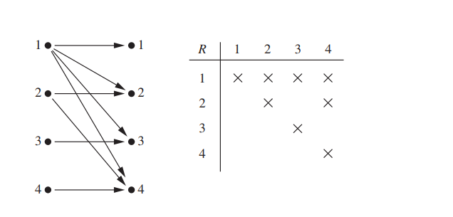
Binary Relation (CO1)
The pairs in this relation are displayed both graphically and in tabular form in following figure.

Slide 51
Domain and Range of Relation (CO1)
Domain of Relation: The Domain of relation R is the set of elements in P which are related to some elements in Q, or it is the set of all first entries of the ordered pairs in R. It is denoted by DOM (R).
Range of Relation: The range of relation R is the set of elements in Q which are related to some element in P, or it is the set of all second entries of the ordered pairs in R. It is denoted by RAN (R).
Example: Relation between even position of A to odd positions of B
Let A = {1, 2, 3, 4}
B = {a, b, c, d, e}
R = {(2, a), (2, c), (2, e), (4, a), (4, c), (4, e)}.
Solution:
|DOM (R)| = 2, 4
RAN (R) = {a, c, e}

Slide 52
Complement of a Relation (CO1)
Consider a relation R from a set A to set B. The complement of relation R denoted by R^{c} is a relation from A to B such that
(XxY-R) = R^{c} = {(a, b): (a, b) ∈ A x B and (a, b) ∉ R}.
Example: Consider the relation R from X to Y
X = {1, 2, 3}
Y = {8, 9}
R = {(1, 8), (2, 8), (1, 9), (3, 9)}
Find the complement relation of R.
Solution:
X x Y = {(1, 8), (2, 8), (3, 8), (1, 9), (2, 9), (3, 9)}
Now we find the complement relation R from X x Y
R^{c} = {(3, 8), (2, 9)}

Slide 53
Inverse of a Relation (CO1)
Consider a relation R from a set A to set B i.e. R ⊆ A x B. The inverse of relation R denoted by R⁻¹ is a relation from B to A i.e. R⁻¹ ⊆ B x A such that
R⁻¹ = {(b, a): (a, b) ∈ R}.
Example:
Consider the relation R from X to Y
X = {1, 2, 3}
Y = {8, 9}
X xY= {(1,8) (2,8), (3,8), (1,9) (2,9), (3,9)}
R = {(1, 8), (2, 8), (1, 9), (3, 9)}
Find the inverse relation of R.
Solution:
R⁻¹ = {(8, 1), (8, 2), (9, 1), (9, 3)}

Slide 54
Operations of a Relations (CO1)
Let A ={1, 2, 3} and B={1, 2, 3, 4}. The relations R1 and R2 from A to B are given as
R1 = {(1, 1), (2, 2), (3, 3)} and R2 = {(1, 1), (1, 2), (1, 3), (1, 4)}
Therefore
R1 ∪ R2 = {(1, 1), (1, 2), (1, 3), (1, 4), (2, 2), (3, 3)}
R1 ∩ R2 = {(1, 1)}
R1 – R2 = {(2, 2), (3, 3)}
R2 – R1= {(1, 2), (1, 3), (1, 4)}

Slide 55
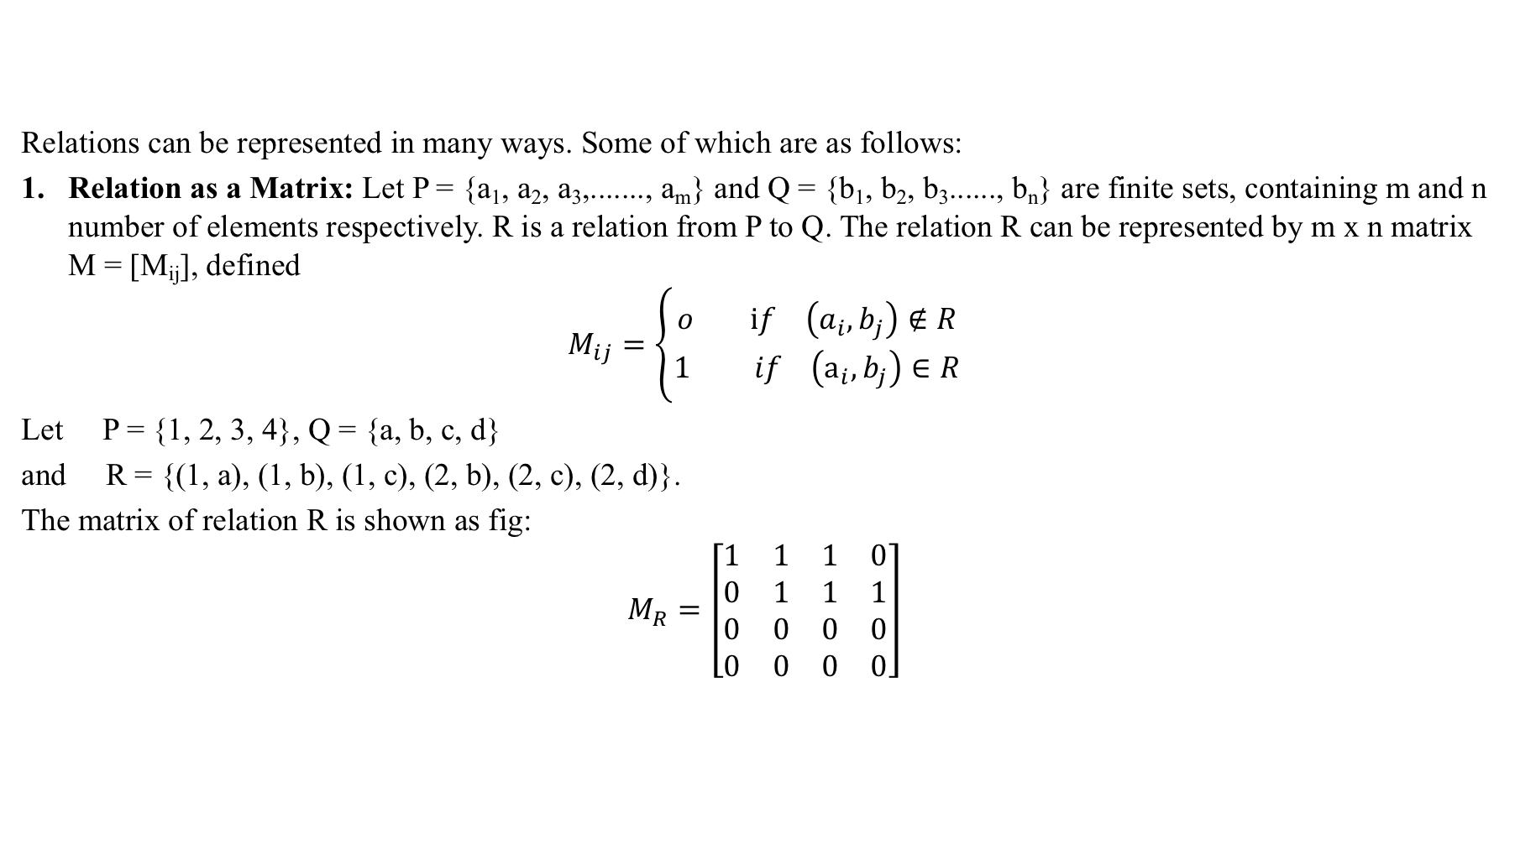
Representation of Relations (CO1)

Slide 56
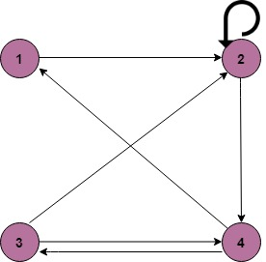
Representation of Relations (CO1)
2. Relation as a Directed Graph: There is another way of picturing a relation R when R is a relation from a finite set to itself.
Example:
A = {1, 2, 3, 4}
R = {(1, 2) (2, 2) (2, 4) (3, 2) (3, 4) (4, 1) (4, 3)}

Slide 57
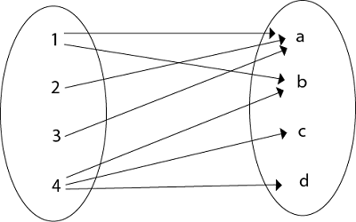
Representation of Relations (CO1)
3. Relation as an Arrow Diagram: If P and Q are finite sets and R is a relation from P to Q. Relation R can be represented as an arrow diagram as follows.
Example:
Let P = {1, 2, 3, 4}
Q = {a, b, c, d}
R = {(1, a), (1, b), (2, a), (3, a), (4, b), (4, c), (4, d)
The arrow diagram of relation R is shown in fig:

Slide 58
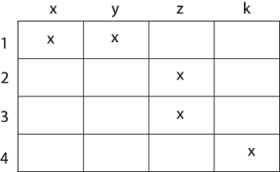
Representation of Relations (CO1)
4. Relation as a Table: If P and Q are finite sets and R is a relation from P to Q. Relation R can be represented in tabular form.
Example
Let P = {1, 2, 3, 4}
Q = {x, y, z, k}
R = {(1, x), (1, y), (2, z), (3, z), (4, k)}.
The tabular form of relation as shown in fig:

Slide 59
Composition of Relations (CO1)
Let A, B, and C be sets, and let R be a relation from A to B and let S be a relation from B to C. That is, R is a subset of A × B i.e. R ⊆ A × B and S is a subset of B × C i.e. S ⊆ B × C. Then R and S give rise to a relation from A to C indicated by R◦S and defined by:
a (R◦S) is possible if for some b ∈ B we have aRb and bSc.
i.e. ,
R ◦ S = {(a, c)| there exists b ∈ B for which (a, b) ∈ R and (b, c) ∈ S}
The relation R◦S is known the composition of R and S; it is sometimes denoted simply by RS.
Let R is a relation on a set A, that is, R is a relation from a set A to itself. Then R◦R, the composition of R with itself. Also, R◦R is sometimes denoted by R². Similarly, R³ = R²◦R = R◦R◦R, and so on. Thus R^{n} is defined for all positive n.

Slide 60
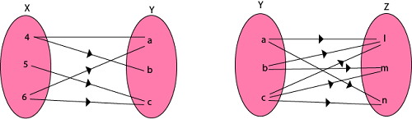
Composition of Relations (CO1)
Example1: Let X = {4, 5, 6}, Y = {a, b, c} and Z = {l, m, n}. Consider the relation R₁ from X to Y and R₂ from Y to Z.
R₁ = {(4, a), (4, b), (5, c), (6, a), (6, c)}
R₁⁻¹ = {(a, 4), (b, 4), (c, 5), (a, 6), (c, 6)}
R₂ = {(a, l), (a, n), (b, l), (b, m), (c, l), (c, m), (c, n)}
Find the composition of relation (i) R₁ o R₂ (ii) R₁o R₁⁻¹

Slide 61
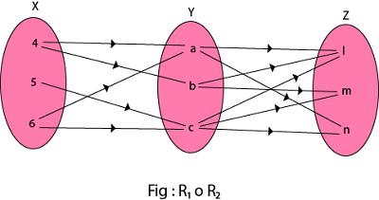
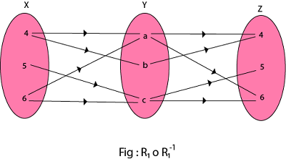
Composition of Relations (CO1)
Solution:
(i) The composition relation R₁ o R₂ as shown in fig:
R₁ o R₂ ={(4, l), (4, n), (4, m), (5, l), (5, m), (5, n), (6, l), (6, m), (6, n)}
(ii) The composition relation R₁o R₁⁻¹ as shown in fig:
R₁ = {(4, a), (4, b), (5, c), (6, a), (6, c)}
R₁⁻¹ = {(a, 4), (b, 4), (c, 5), (a, 6), (c, 6)}
R₁o R₁⁻¹ = {(4, 4), (5, 5), (5, 6), (6, 4), (6, 5), (4, 6), (6, 6)}
X

Slide 62
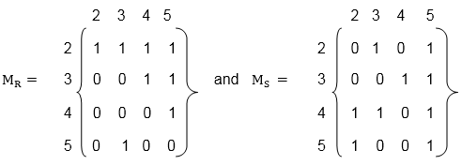
Composition of Relations and Matrices (CO1)
There is another way of finding R◦S. Let M_{R} and M_{S} denote respectively the matrix representations of the relations R and S. Then
Example:
Let A = {2, 3, 4, 5}. Consider the relation R and S on A defined by
R = {(2, 2), (2, 3), (2, 4), (2, 5), (3, 4), (3, 5), (4, 5), (5, 3)}
S = {(2, 3), (2, 5), (3, 4), (3, 5), (4, 2), (4, 3), (4, 5), (5, 2), (5, 5)}.
Find the matrices of the above relations. Use matrices to find the following composition of the relation R and S.
(i) RoS (ii) RoR (iii) SoR

Slide 63
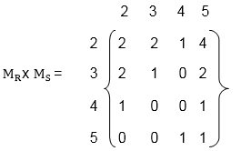
Composition of Relations and Matrices (CO1)
(i) To obtain the composition of relation R and S. First multiply M_{R} with M_{S} to obtain the matrix M_{R} x M_{S} as shown in fig:
The non zero entries in the matrix M_{R} x M_{S} tells the elements related in RoS. So,
Hence the composition R o S of the relation R and S is
R o S = {(2, 2), (2, 3), (2, 4), (2, 5), (3, 2), (3, 3), (3, 5), (4, 2), (4, 5), (5, 4), (5, 5)}.

Slide 64
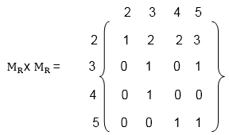
Composition of Relations and Matrices (CO1)
(ii) First, multiply the matrix M_{R} by itself, as shown in fig
Hence the composition R o R of the relation R and S is
R o R = {(2, 2), (2, 3),(2, 4 ), (2, 5) (3, 3), (3, 5) (4, 3), (5, 4), (5, 5)}

Slide 65
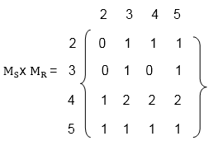
Composition of Relations and Matrices (CO1)
(iii) Multiply the matrix M_{S} with M_{R} to obtain the matrix M_{S} x M_{R} as shown in fig:
The non-zero entries in matrix M_{S} x M_{R} tells the elements related in SoR.
Hence the composition S o R of the relation S and R is
S o R = {(2,3),(2, 4) , (2, 5), (3, 3), (3, 5), (4, 2),(4,3) (4, 4), (4, 5), (5, 2), (5, 3), (5, 4), (5, 5)}.

Slide 66
Types of Relations (CO1)
Reflexive Relation:
A relation R on set A is said to be a reflexive if (a, a) ∈ R for every a ∈ A.
Example:
If A = {1, 2, 3, 4} then R = {(1, 1) (2, 2), (1, 3), (2, 4), (3, 3), (3, 4), (4, 4)}. Is a relation reflexive?
Solution:
The relation is reflexive as for every a ∈ A implies (a, a) ∈ R,
i.e. (1, 1), (2, 2), (3, 3), (4, 4) ∈ R.

Slide 67
Types of Relations (CO1)
Irreflexive Relation:
A relation R on set A is said to be irreflexive if (a, a) ∉ R for every a ∈ A.
Example:
Let A = {1, 2, 3} and R = {(1, 2), (2, 2), (3, 1), (1, 3)}. Is the relation R reflexive or irreflexive?
Solution:
The relation R is not reflexive as for every a ∈ A implies (a, a) ∉ R, i.e., (1, 1) and (3, 3) ∉ R.
The relation R is not irreflexive, if (a, a) ∈ R, for some a ∈ A, i.e., (2, 2) ∈ R.

Slide 68
Types of Relations (CO1)
Symmetric Relation: A relation R on set A is said to be symmetric
if (a, b) ∈ R ⟺ (b, a) ∈ R for all a, b ∈ R
Relation ⊥ is symmetric since a line a is ⊥ to b, then b is ⊥ to a.
Also, Parallel is symmetric, since if a line a is ∥ to b then b is also ∥ to a.
Example: Let A = {1, 2, 3} and R = {(1, 1), (2, 2), (1, 2), (2, 1), (2, 3), (3, 2)}. Is a relation R symmetric or not?
Solution: The relation is symmetric as for every (a, b) ∈ R, we have (b, a) ∈ R, i.e., (1, 2), (2, 1), (2, 3), (3, 2) ∈ R but not reflexive because (3, 3) ∉ R.

Slide 69
Types of Relations (CO1)
4. Antisymmetric Relation: A relation R on a set A is said to be antisymmetric if (a, b) ∈ R, (b, a) ∈ R and a = b.
Example: Let A = {1, 2, 3} and R = {(1, 1), (2, 2)}. Is the relation R antisymmetric?
Solution: The relation R is antisymmetric as a = b when (a, b) and (b, a) both belong to R.

Slide 70
Types of Relations (CO1)
5. Asymmetric Relation: A relation R on a set A is called an Asymmetric Relation if for every (a, b) ∈ R implies that (b, a) does not belong to R.
6. Transitive Relations: A Relation R on set A is said to be transitive if (a, b) ∈ R and (b, c) ∈ R ⇒ (a, c) ∈ R for a, b, c ∈ R
Example1: Let A = {1, 2, 3} and R = {(1, 2), (2, 1), (1, 1), (2, 2)}. Is the relation transitive?
Solution: The relation R is transitive as for every (a, b), (b, c) belong to R, we have (a, c) ∈ R i.e, (1, 2) (2, 1) ∈ R ⇒ (1, 1) ∈ R.

Slide 71
Types of Relations (CO1)
7. Identity Relation: Identity relation I_{A} on set A is defined as
I_{A} = {(a, a) | a ∈ A }
Example: A= {1, 2, 3} = {(1, 1), (2, 2), (3, 3)}
8. Void Relation: It is given by R: A →B such that R = ∅ (⊆ A x B) is a null relation. Void Relation R = ∅ is symmetric and transitive but not reflexive.
9. Universal Relation: A relation R: A →B such that R = A x B (⊆ A x B) is a universal relation. Universal Relation from A →B is reflexive, symmetric and transitive. So this is an equivalence relation.

Slide 72
Closure Properties of Relations (CO1)
Consider a given set A, and the collection of all relations on A.
Let P be a property of such relations, such as being symmetric or being transitive. A relation with property P will be called a P-relation.
The closure of a relation R with respect to property P is the relation obtained by adding the minimum number of ordered pairs to R to obtain property P.
(1) Reflexive and Symmetric Closures: The next theorem tells us how to obtain the reflexive and symmetric closures of a relation easily.
Theorem: Let R be a relation on a set A. Then:
R ∪ ∆_{A} is the reflexive closure of R
R ∪ R⁻¹ is the symmetric closure of R.

Slide 73
Closure Properties of Relations (CO1)
Example1: Let A = {k, l, m}. Let R is a relation on A defined by
R = {(k, k), (k, l), (l, m), (m, k)}.
Find the reflexive closure of R.
Solution: R ∪ ∆ is the smallest relation having reflexive property,
Hence, R_{F} = R ∪ ∆ = {(k, k), (k, l), (l, l), (l, m), (m, m), (m, k)}.
Example2: Consider the relation R on A = {4, 5, 6, 7} defined by
R = {(4, 5), (5, 5), (5, 6), (6, 7), (7, 4), (7, 7)}
Find the symmetric closure of R.
Solution: The smallest relation containing R having the symmetric property is R ∪ R⁻¹,i.e.
R_{S} = R ∪ R⁻¹ = {(4, 5), (5, 4), (5, 5), (5, 6), (6, 5), (6, 7), (7, 6), (7, 4), (4, 7), (7, 7)}.

Slide 74
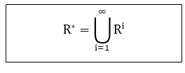
Closure Properties of Relations (CO1)
(2)Transitive Closures: Consider a relation R on a set A. The transitive closure R of a relation R is the smallest transitive relation containing R.
Recall that R² = R◦ R and R^{n} = R^{n-1} ◦ R. We define:
The following Theorem applies:
Theorem1: R* is the transitive closure of R
Suppose A is a finite set with n elements. Then R* = R ∪R² ∪.....∪ R^{n}
Theorem 2: Let R be a relation on a set A with n elements. Then
Transitive (R) = R ∪ R²∪.....∪ R^{n}

Slide 75
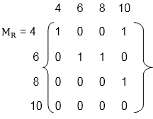
Closure Properties of Relations (CO1)
Example1: Consider the relation R = {(1, 2), (2, 3), (3, 3)} on A = {1, 2, 3}. Then R² = R◦ R = {(1, 3), (2, 3), (3, 3)} and R³ = R² ◦ R = {(1, 3), (2, 3), (3, 3)} Accordingly, Transitive (R) = {(1, 2), (2, 3), (3, 3), (1, 3)}
Example2: Let A = {4, 6, 8, 10} and R = {(4, 4), (4, 10), (6, 6), (6, 8),
(8, 10)} is a relation on set A. Determine transitive closure of R.
Solution: The matrix of relation R is shown in fig:

Slide 76
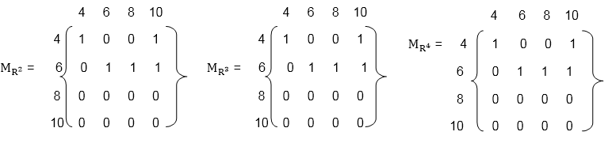
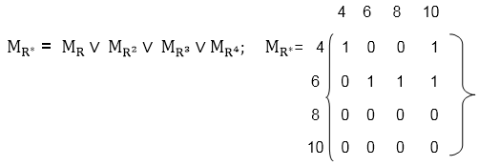
Closure Properties of Relations (CO1)
Now, find the powers of M_{R} as in fig:
Hence, the transitive closure of M_{R} is M_{R}* as shown in Fig (where M_{R}* is the O Ring of a power of M_{R})
Thus, R* = {(4, 4), (4, 10), (6, 8), (6, 6), (6, 10), (8, 10)}

Slide 77
Equivalence Relation (CO1)
Consider the set of every person in the world
Now consider a R relation such that (a,b)∈R if a and b are siblings.
Clearly this relation is
Reflexive
Symmetric, and
Transitive
Such a relation is called an equivalence relation.
Definition: A relation on a set A is an equivalence relation if it is reflexive, symmetric, and transitive
Example: Let R={ (a,b) | a,b∈R and a≤b}
Is R reflexive?
Is it transitive?
Is it symmetric?
No, it is not. 4 is related to 5 (4 ≤ 5) but 5 is not related to 4
Thus R is not an equivalence relation

Slide 78
Daily Quiz(CO1)
The binary relation {(1,1), (2,1), (2,2), (2,3), (2,4), (3,1), (3,2)} on the set {1, 2, 3} is __________ a) reflective, symmetric and transitive b) irreflexive, symmetric and transitive c) neither reflective, nor irreflexive but transitive d) irreflexive and antisymmetric
Consider the binary relation, A = {(a,b) | b = a – 1 and a, b belong to {1, 2, 3}}. The reflexive transitive closure of A is? a) {(a,b) | a >= b and a, b belong to {1, 2, 3}} b) {(a,b) | a > b and a, b belong to {1, 2, 3}} c) {(a,b) | a <= b and a, b belong to {1, 2, 3}} d) {(a,b) | a = b and a, b belong to {1, 2, 3}}

Slide 79
Daily Quiz(CO1)
3. Let A and B be two non-empty relations on a set S. Which of the following statements is false? a) A and B are transitive ⇒ A∩B is transitive b) A and B are symmetric ⇒ A∪B is symmetric c) A and B are transitive ⇒ A∪B is not transitive d) A and B are reflexive ⇒ A∩B is reflexive
4. R is a binary relation on a set S and R is reflexive if and only if _______ a) r(R) = R b) s(R) = R c) t(R) = R d) f(R) = R

Slide 80
Daily Quiz(CO1)
5. The condition for a binary relation to be symmetric is _______ a) s(R) = R b) R ∪ R = R c) R = R^{c} d) f(R) = R
6. Amongst the properties {reflexivity, symmetry, antisymmetry, transitivity} the relation R={(a,b) ∈ N² | a!= b} satisfies _______ property. a) symmetry b) transitivity c) antisymmetry d) reflexivity

Slide 81
Daily Quiz(CO1)
7. Let R₁ and R₂ be two equivalence relations on a set. Is R₁ ∪ R₂ an equivalence relation? a) an equivalence relation b) reflexive closure of relation c) not an equivalence relation d) partial equivalence relation
8. The binary relation U = Φ (empty set) on a set A = {11, 23, 35} is _____ a) Neither reflexive nor symmetric b) Symmetric and reflexive c) Transitive and reflexive d) Transitive and symmetric

Slide 82
Topic Objective: Function (CO1)
The student will be able to:
use the composition of logarithms and the floor or ceiling functions to solve problems.
give complete or partial arrow diagrams for iterated functions.
use algebraic methods to locate all cycles of length 1 and length 2 for given functions.
use the principle of mathematical induction to prove that a given sequence eventually reaches one of several cycles.

Slide 83
Topic Prerequisite & Recap (CO1)
Prerequisite
Basic Understanding of Set Theory & Relations.
Recap
To develop the logical thinking by using Sets and Relations concepts and use in upcoming topic. i.e. Functions.

Slide 84
Functions (CO1)
A Function assigns to each element of a set to exactly one element of a related set.
Functions find their application in various fields like representation of the computational complexity of algorithms, counting objects, study of sequences and strings, to name a few.
It is a mapping in which every element of set A is uniquely associated at the element with set B. The set of A is called Domain of a function and set of B is called Co domain.
Domain of a Function: Let f be a function from P to Q.
The set P is called the domain of the function f.
Co-Domain of a Function: Let f be a function from P to Q.
The set Q is called Co-domain of the function f.

Slide 85
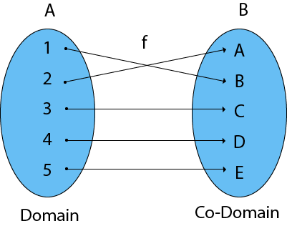
Functions (CO1)
Range of a Function: The range of a function is the set of picture of its domain. In other words, we can say it is a subset of its co-domain. It is denoted as f (domain).
If f: P → Q, then f (P) = {f(x): x ∈ P} = {y: y ∈ Q | ∃ x ∈ P, such that f (x) = y}.

Slide 86
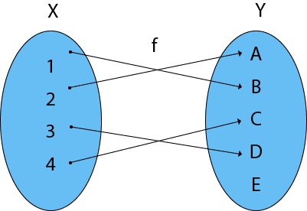
Example (CO1)
Example: Find the Domain, Co-Domain, and Range of function.
Let x = {1, 2, 3, 4}
y = {a, b, c, d, e}
f = {(1, b), (2, a), (3, d), (4, c)
Solution:
Domain of function: {1, 2, 3, 4}
Range of function: {a, b, c, d}
Co-Domain of function: {a, b, c, d, e}

Slide 87
Function mapping (CO1)
Definition: A function f from set A to set B, denoted by f: A→B, is an assignment of each element of A to exactly one element of B.
We write f(a) = b if b is the unique element of B assigned to the element a of A.
Students
Grades
Functions are also called mappings
A
Jay
B
Vijay
C
Ajay
D
F
Sanjay

Slide 88
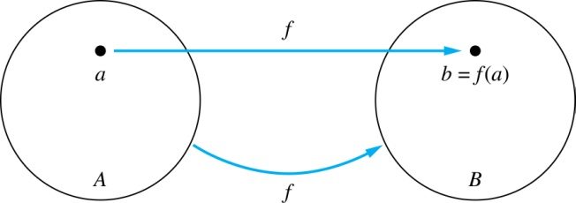
Function mapping (CO1)
Given a function f: A → B
A is called the domain of f
B is called the codomain of f
f is a mapping from A to B
If f(a) = b
then b is called the image of a under f
a is called the preimage of b
The range (or image) of f is the set of all images of points in A. We denote it by f(A).

Slide 89
Function mapping (CO1)
The domain of f is A
The codomain of f is B
The image of b is y
f(b) = y
The preimage of y is b
The preimage of z is {a,c,d}
The range/image of A is {y,z}
f(A) = {y,z}
A
B
a
x
b
y
c
d
z

Slide 90
Representing Functions (CO1)
Functions may be specified in different ways:
An explicit statement of the assignment.
Students and grades example.
A formula.
f(x) = x + 1
A computer program.
A Java program that when given an integer n, produces the nth Fibonacci Number

Slide 91
Injective function(CO1)
Definition: A function f is one-to-one, or injective, if a ≠ b implies that f(a) ≠ f(b) for all a and b in the domain of f.
A
B
a
x
v
b
y
c
z
d
w

Slide 92
Surjective function (CO1)
Definition: A function f from A to B is called onto or surjective, if for every element b ∈ B there exists an element a ∈ A with f(a) = b
A
B
a
x
b
y
c
z
d

Slide 93
Bijective function (CO1)
Definition: A function f is a one-to-one correspondence, or a bijection, if it is both one-to-one and onto (surjective and injective)
A
B
a
x
b
y
c
d
z
w

Slide 94
Showing that f is/is not injective or surjective (CO1)
Consider a function f: A → B
f is injective if:
∀x,y ∈ A ( x ≠ y → f(x) ≠ f(y) )
f is not injective if:
∃x,y ∈ A ( x ≠ y ∧ f(x) = f(y) )
f is surjective if:
∀y ∈ B ∃x ∈ A ( f(x) = y )
f is not surjective if:
∃y ∈ B ∀x ∈ A (f(x) ≠ y)
∀ - Universal quantifier (For all)
∃ - Existential quantifier (there exit)

Slide 95
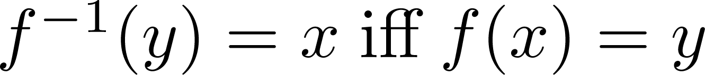
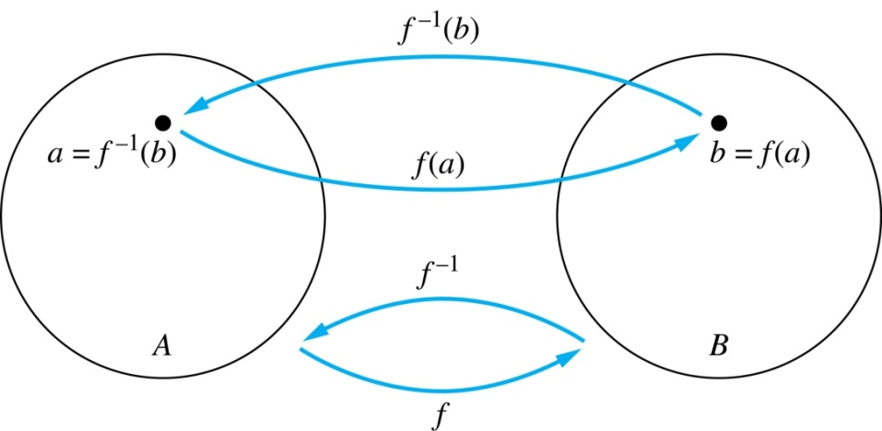
Inverse of a Function (CO1)
Definition: Let f be a bijection from A to B. Then the inverse of f, denoted f ^{–1}, is the function from B to A defined as
No inverse exists unless f is a bijection.

Slide 96
Inverse of a Function (CO1)
Example 1:
Let f be the function from {a,b,c} to {1,2,3}
f(a)=2, f(b)=3, f(c)=1.
Is f invertible and if so what is its inverse?
Solution:
f is invertible because it is a bijection
f ^{–1} reverses the correspondence given by f:
f ^{–1}(1)=c, f ^{–1}(2)=a, f ^{–1}(3)=b.

Slide 97
Inverse of a Function (CO1)
Example 2:
Let f: R → R be such that f(x) = x²
Is f invertible, and if so, what is its inverse?
Solution:
The function f is not invertible because it is not one-to-one

Slide 98
Inverse of a Function (CO1)
Example 3:
Let f: Z → Z be such that f(x) = x + 1
Is f invertible and if so what is its inverse?
Solution:
The function f is invertible because it is a bijection
f ^{–1} reverses the correspondence:
f ^{–1}(y) = y – 1

Slide 99
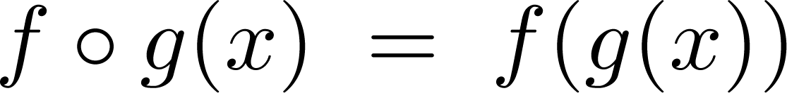
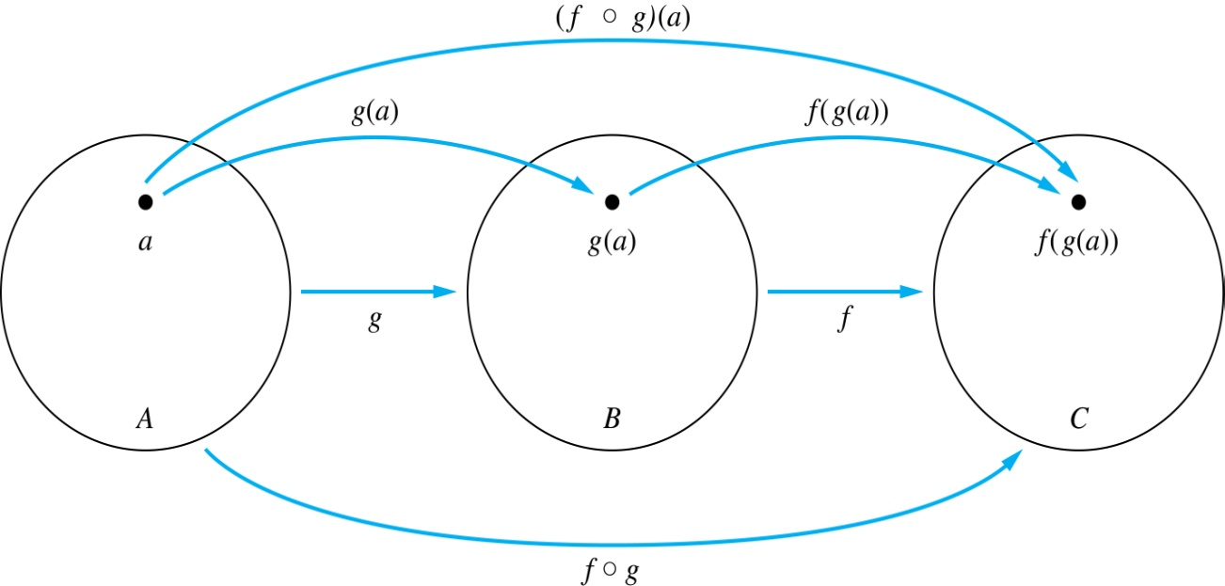
Composition of function (CO1)
Definition: Let f: B → C, g: A → B. The composition of f with g, denoted f ∘ g is the function from A to C defined by

Slide 100
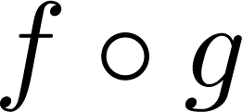
Composition of function (CO1)
A
g
B
f
C
A
C
a
v
a
h
h
b
i
b
i
w
c
c
x
j
j
d
d
y

Slide 101




Composition of function (CO1)
Example: If and then
and

Slide 102
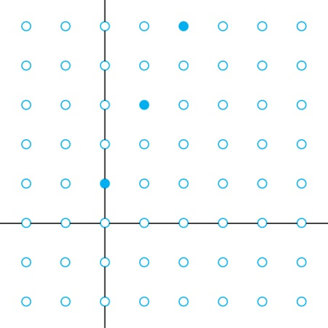
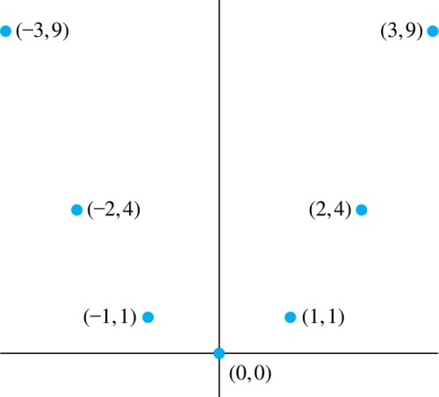
Graphs of Functions (CO1)
Let f be a function from the set A to the set B. The graph of the function f is the set of ordered pairs
{(a,b) | a ∈A and f(a) = b}
Graph of f(n) = 2n+1
from Z to Z
Graph of f(x) = x²
from Z to Z

Slide 103
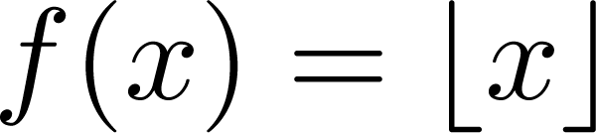
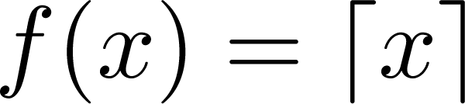
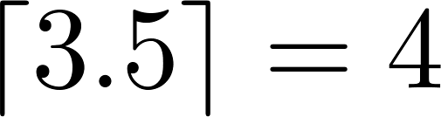
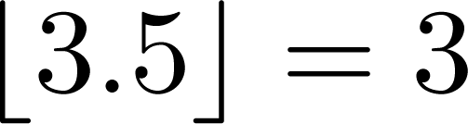
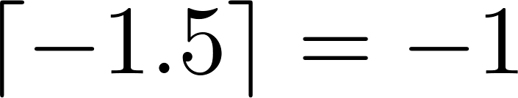
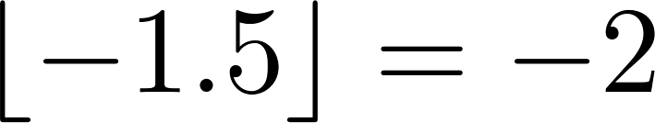
Some Important Functions (CO1)
The floor function, denoted
is the largest integer less than or equal to x.
The ceiling function, denoted
is the smallest integer greater than or equal to x
Examples:

Slide 104
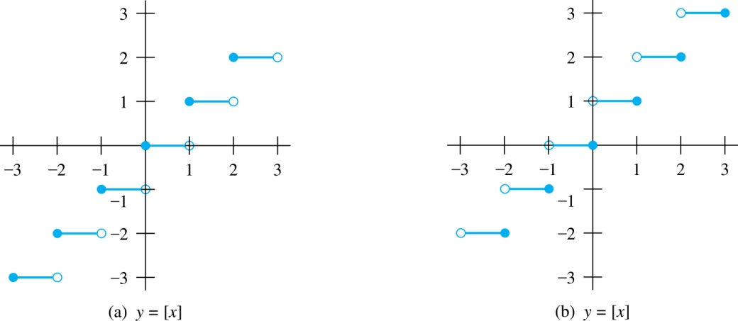
Some Important Functions (CO1)
Floor Function (≤x) Ceiling Function (≥x)

Slide 105
Factorial Function (CO1)
Definition: f: N → Z⁺, denoted by f(n) = n! is the product of the first n natural numbers:
f(n) = 1 ∙ 2 ∙∙∙ (n–1) ∙ n for n>0
f(0) = 0! = 1
Examples:
f(1) = 1! = 1
f(2) = 2! = 1 ∙ 2 = 2
f(6) = 6! = 1 ∙ 2 ∙ 3 ∙ 4 ∙ 5 ∙ 6 = 720
f(20) = 2,432,902,008,176,640,000

Slide 106
Daily Quiz(CO1)
A function is said to be ______________ if and only if f(a) = f(b) implies that a = b for all a and b in the domain of f. a) One-to-many b) One-to-one c) Many-to-many d) Many-to-one
The value of ⌊1/2.⌊5/2⌋ ⌋ is ______________ a) 1 b) 2 c) 3 d) 0.5
Which of the following function f: Z X Z → Z is not onto? a) f(a, b) = a + b b) f(a, b) = a c) f(a, b) = |b| d) f(a, b) = a – b

Slide 107
Daily Quiz(CO1)
4. The g ⁻¹({0}) for the function g(x)= ⌊x⌋ is ___________ a) {x | 0 ≤ x < 1} b) {x | 0 < x ≤ 1} c) {x | 0 < x < 1} d) {x | 0 ≤ x ≤ 1}
5. The inverse of function f(x) = x³ + 2 is ____________ a) f ⁻¹ (y) = (y – 2) ^{1/2} b) f ⁻¹ (y) = (y – 2) ^{1/3} c) f ⁻¹ (y) = (y) ^{1/3} d) f ⁻¹ (y) = (y – 2)
Notes:
The number of ways of arranging 12 objects around a circle is in 12! ways. Now the sisters can be arranged on either side of the person who is in between the sisters in 2! ways. The person who sits in between the two sisters can be any of the 15 in the group and can be selected in 15 ways. Therefore, the total number of ways 15 *12! * 2!.

Slide 108
Faculty Video Links, Youtube & NPTEL Video Links and Online Courses Details (CO1)
Youtube/other Video Links
https://swayam.gov.in/nd1_noc19_cs49
NEPTEL video link:
https://nptel.ac.in/courses/111/105/111105112/

Slide 109
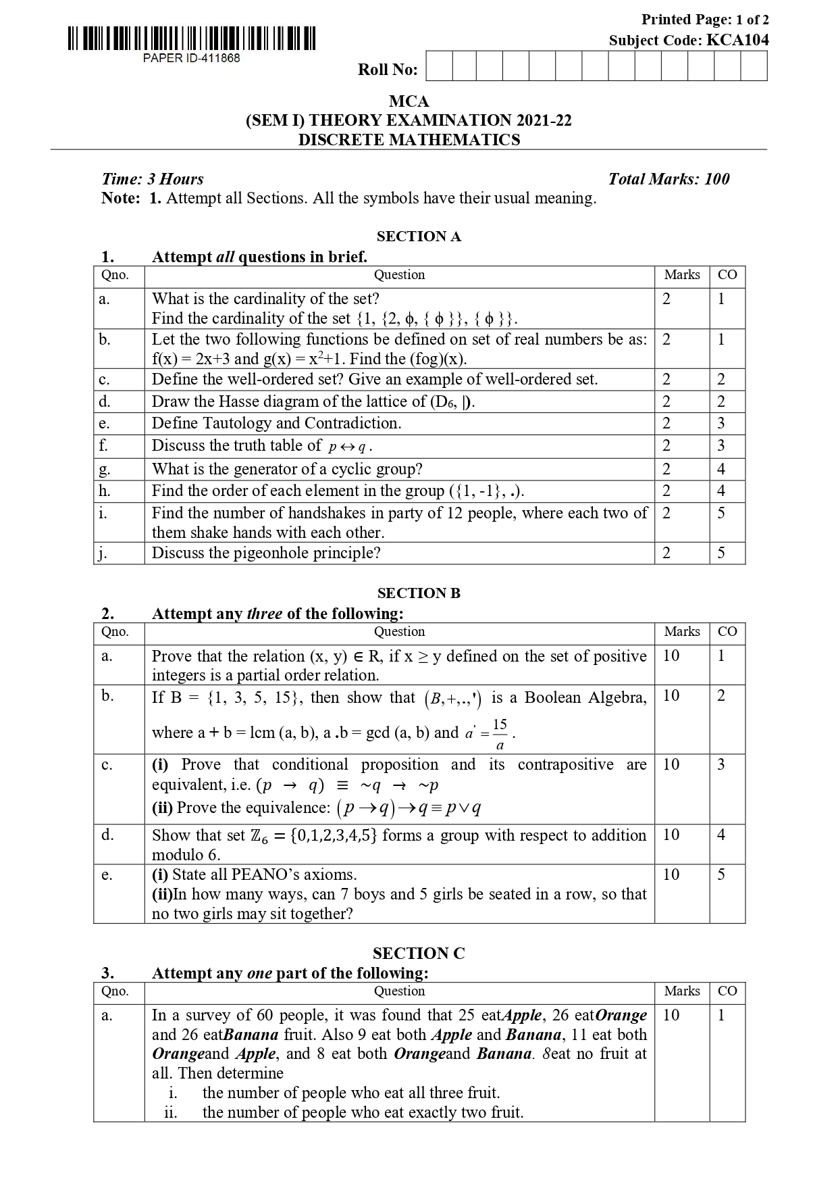
Old Question Papers (CO2)

Slide 110
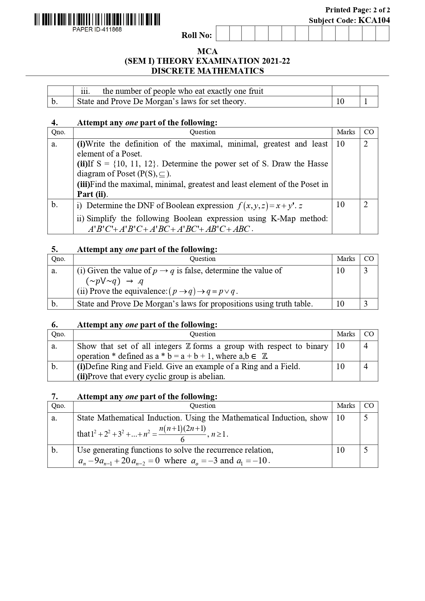
Old Question Papers (CO2)

Slide 111
Text Books & References
Text books:
Koshy, Discrete Mathematics, Elsevier Pub. 2008 Kenneth H. Rosen, Discrete Mathematics and Its Applications, 6/e, McGraw-Hill, 2006.
B. Kolman, R.C. Busby, and S.C. Ross, Discrete Mathematical Structures, 5/e, Prentice Hall, 2004.
E.R. Scheinerman, Mathematics: A Discrete Introduction, Brooks/Cole, 2000.
R.P. Grimaldi, Discrete and Combinatorial Mathematics, 5/e, Addison Wesley, 2004
Reference Books:
Liptschutz, Seymour, “ Discrete Mathematics”, McGraw Hill.
Trembley, J.P & R. Manohar, “Discrete Mathematical Structure with Application to Computer Science”, McGraw Hill.
Narsingh Deo, “Graph Theory With application to Engineering and Computer Science.”, PHI.
Krishnamurthy, V., “Combinatorics Theory & Application”, East-West Press Pvt. Ltd., New Delhi

Slide 112
Thank You

